Slide 1
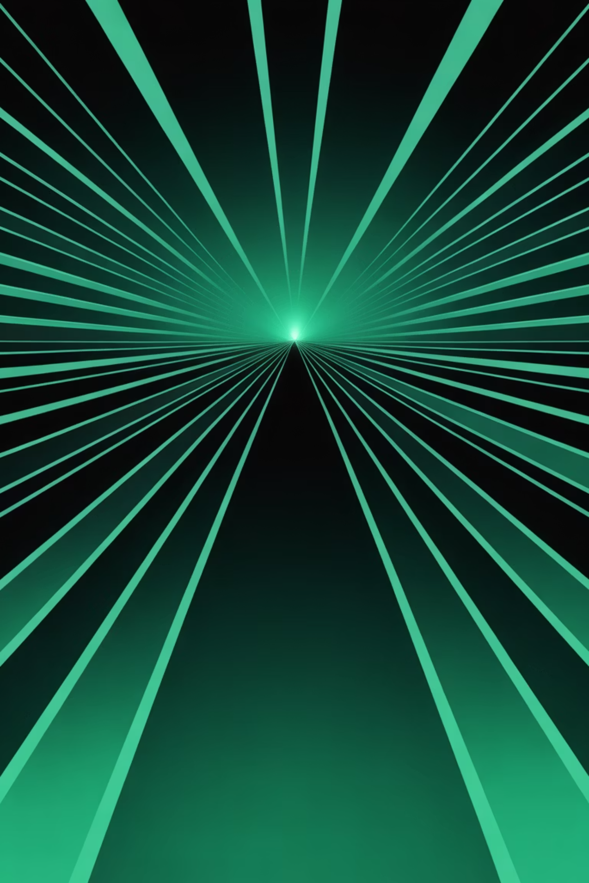
IHRAZ Brand Identity Guidelines
Presented by Mohamad-Zouheir ChoumanFounder & CEO

Slide 2
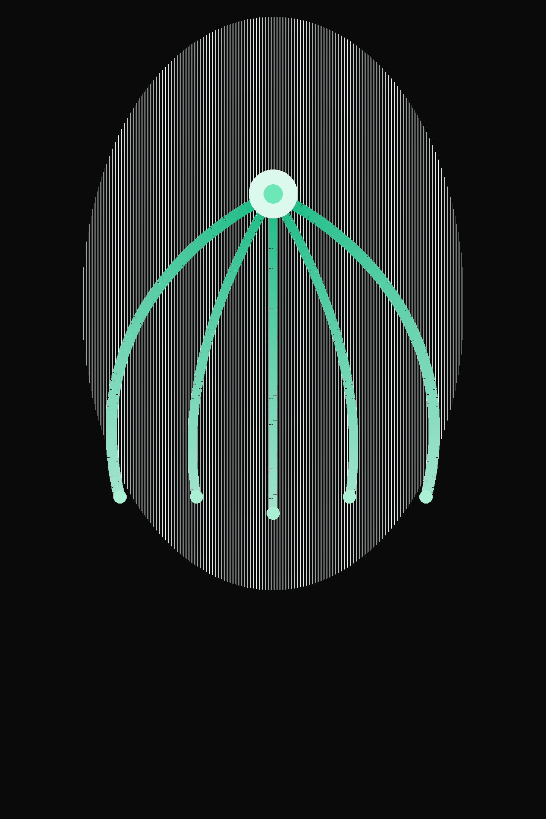
The Brand Story
إحراز
Our Mission
IHRAZ — from the Arabic إحراز meaning "to achieve, to attain, to score."
We built IHRAZ to be the convergence point — where project management intelligence meets performance analytics, where scattered data streams unite into strategic clarity.
In a world drowning in fragmented dashboards and siloed project data, IHRAZ was born from a simple conviction: enterprise leaders deserve a single source of truth.
SAUDI BORN
GLOBALLY ENGINEERED

Slide 3
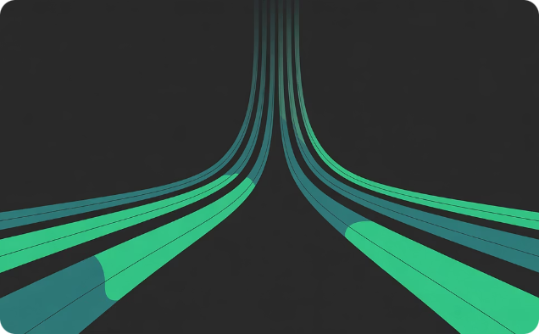
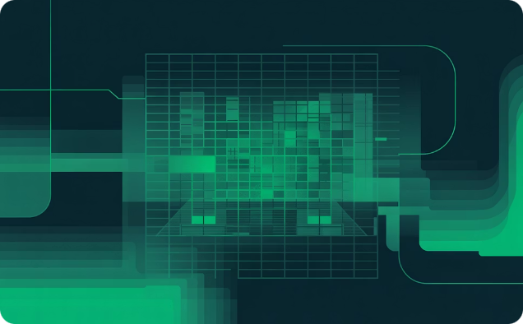
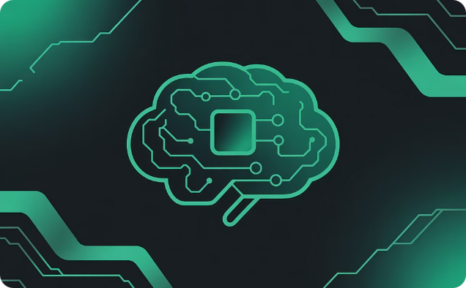
Brand Philosophy
Three founding principles shape everything IHRAZ is — from product to pixel.
Convergence
Precision
Intelligence
Five data streams merging into one apex of insight. This is our Convergence Mark — the visual soul of IHRAZ, representing the transformation from fragmented data to unified intelligence.
Every pixel, every metric, every decision is backed by real data. Precision is not a feature — it is a discipline embedded in our design language and product architecture.
AI doesn't just report. It predicts, recommends, and accelerates. IHRAZ transforms raw data into actionable foresight, empowering leaders to move with confidence.

Slide 4
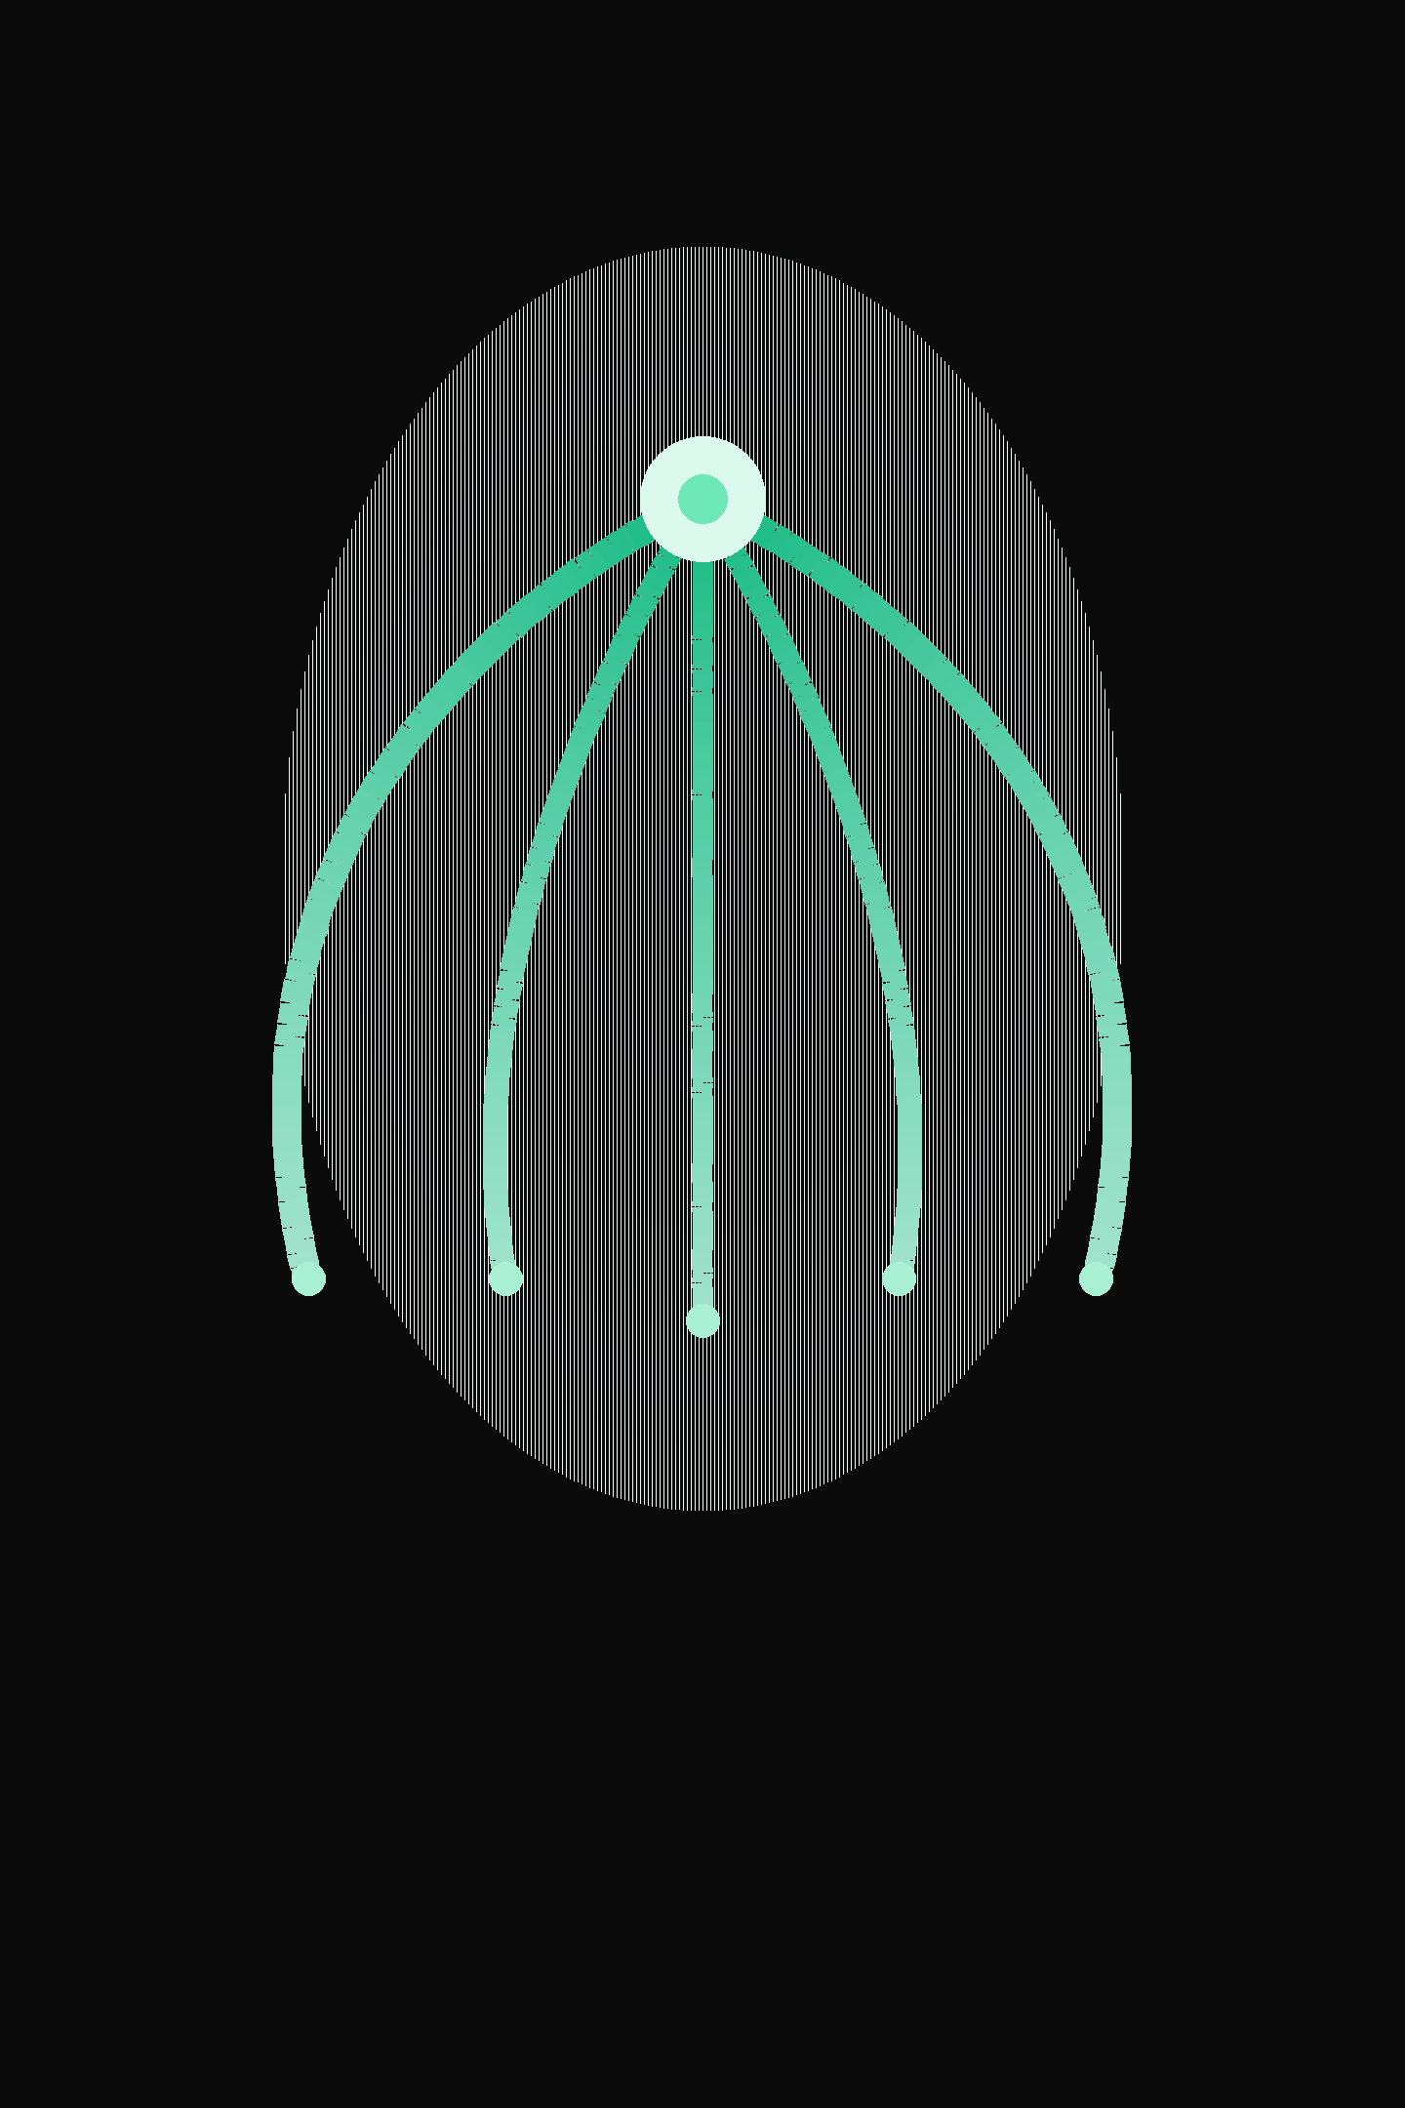
Visual Identity — The Convergence Mark
Five curved paths flow from a wide base to a single apex point, symbolizing five data streams converging into one unified insight. The mark is our most sacred brand asset — a geometric statement of purpose rendered in emerald and light.
Approved Usage
App icons & favicons
Document watermarks
Loading animations
Presentation accents
Document headers
Emerald Arcs
#10B981 on deep black
Apex Point
#6EE7B7 luminous highlight
Base Canvas
#0A0A0A deep black ground

Slide 5
Color System
The Emerald Spectrum — a carefully curated palette built for dark, premium digital environments. Each value is intentional, carrying specific functional weight across UI, data, and brand expression.
Deep Black
Emerald 800
Emerald 600
#0A0A0A
Primary background, authority, depth
#064E3B
Deep accents, subtle surfaces
#059669
Secondary accent, hover states
Emerald 500
Emerald 300
#10B981
Primary brand color, CTAs
#6EE7B7
Apex points, special highlights
Text Hierarchy
Color Principle
Primary — #F5F5F0
Never use more than two Emerald variants in a single composition. Reserve Emerald 300 exclusively for apex highlights and premium accent moments.
Headlines and body text — maximum legibility on dark surfaces
Secondary — #CCCCCC
Supporting text — hierarchy without competition
Muted — #999999
Captions and labels — quiet but present

Slide 6

Typography System
Four purpose-built typefaces — each selected for a specific communicative role. Together they form a coherent, multilingual typographic voice.
Syne — Display & Headlines
Space Grotesk — Body Text
Bold, geometric, unmistakably distinctive. Syne carries the IHRAZ brand name, section headers, and hero text. Weights: 700–800. The architectural backbone of brand expression.
Clean, technical, and modern. Space Grotesk is the primary reading font across all long-form content — reports, documents, and interface copy. Weights: 300–600.
Cairo — Arabic & Bilingual
Inter — UI & Data
Elegant and balanced, Cairo ensures IHRAZ speaks with equal sophistication in Arabic-first communications and bilingual layouts. Weights: 400–700.
Engineered for precision at small sizes. Inter powers dashboards, data labels, and all interface elements where readability at density is critical. Weights: 300–600.

Slide 7
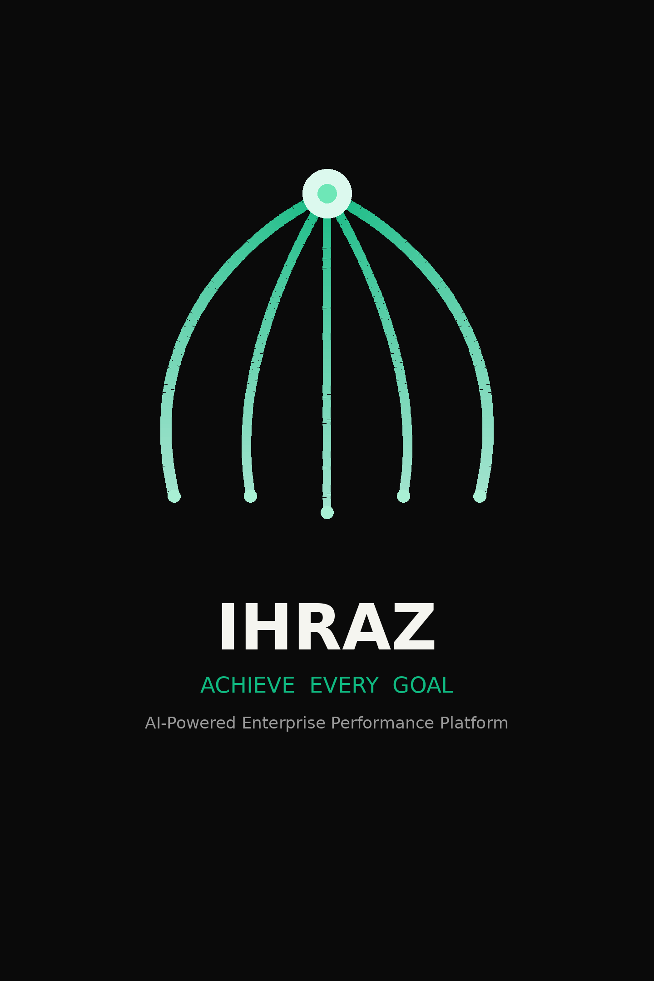
Logo Specifications
Construction
Usage Rules
The IHRAZ logo combines the Convergence Mark with the wordmark set in Syne Extra Bold — creating a lockup that is both architectural and alive.
Clear Space: Minimum 1× the height of the mark on all sides — never crowd the mark.
Minimum Size: 32px height for digital applications; 12mm for all print output.
Variants
Dark: Emerald mark + white text on dark backgrounds
Light: Dark mark + dark text on light backgrounds
Never: Stretch, rotate, apply drop shadows, add outlines, or alter the approved color values of the logo under any circumstance.

Slide 8
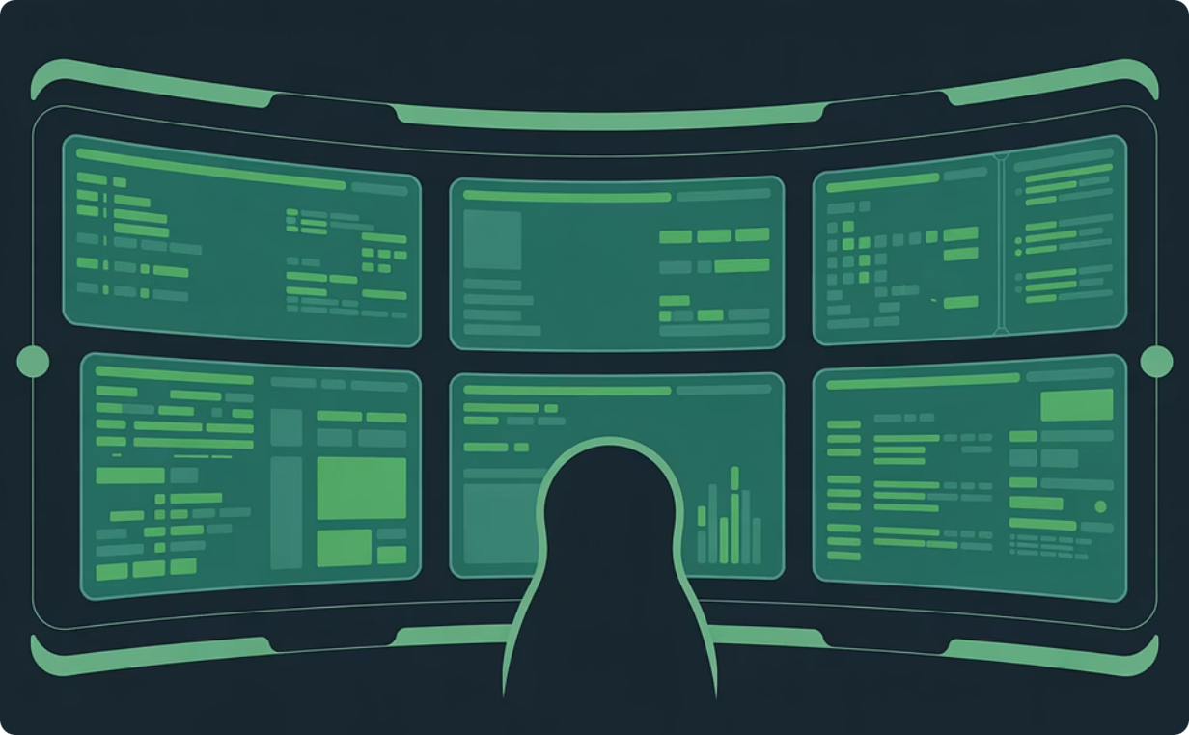
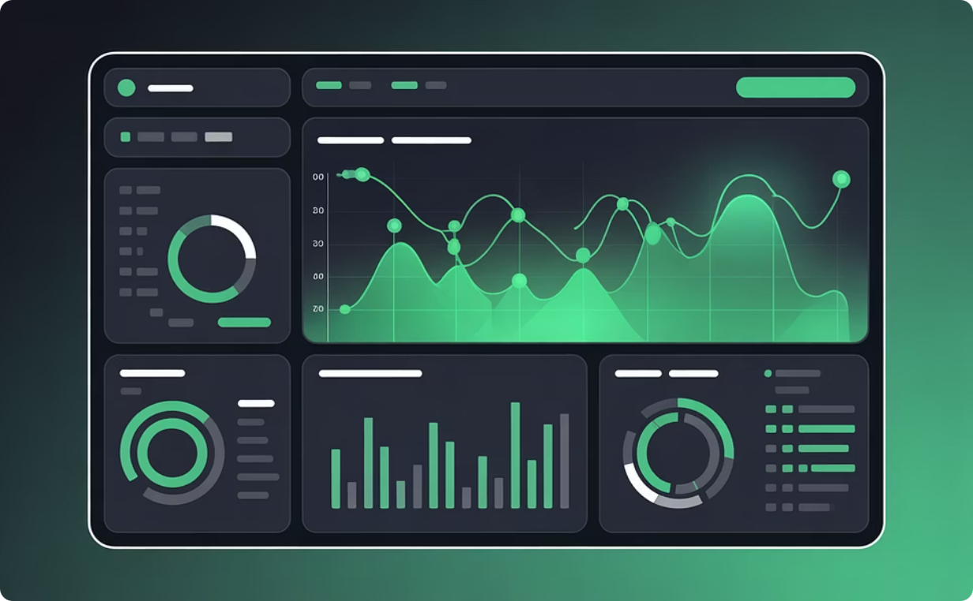

Platform Architecture
IHRAZ is built around two tightly integrated modules sharing a unified data foundation — enabling the cross-functional intelligence that siloed tools can never provide.
PMO Hub Module
KPI Dashboard Module
Portfolio management & timeline tracking
Resource allocation & risk intelligence
Milestone automation
Complete project management command center
Real-time metrics & performance dashboards
Predictive analytics & goal tracking
Executive reporting suite
Live enterprise performance intelligence
Both modules share a unified data foundation — delivering cross-functional insights and strategic clarity that isolated tools fundamentally cannot achieve.

Slide 9
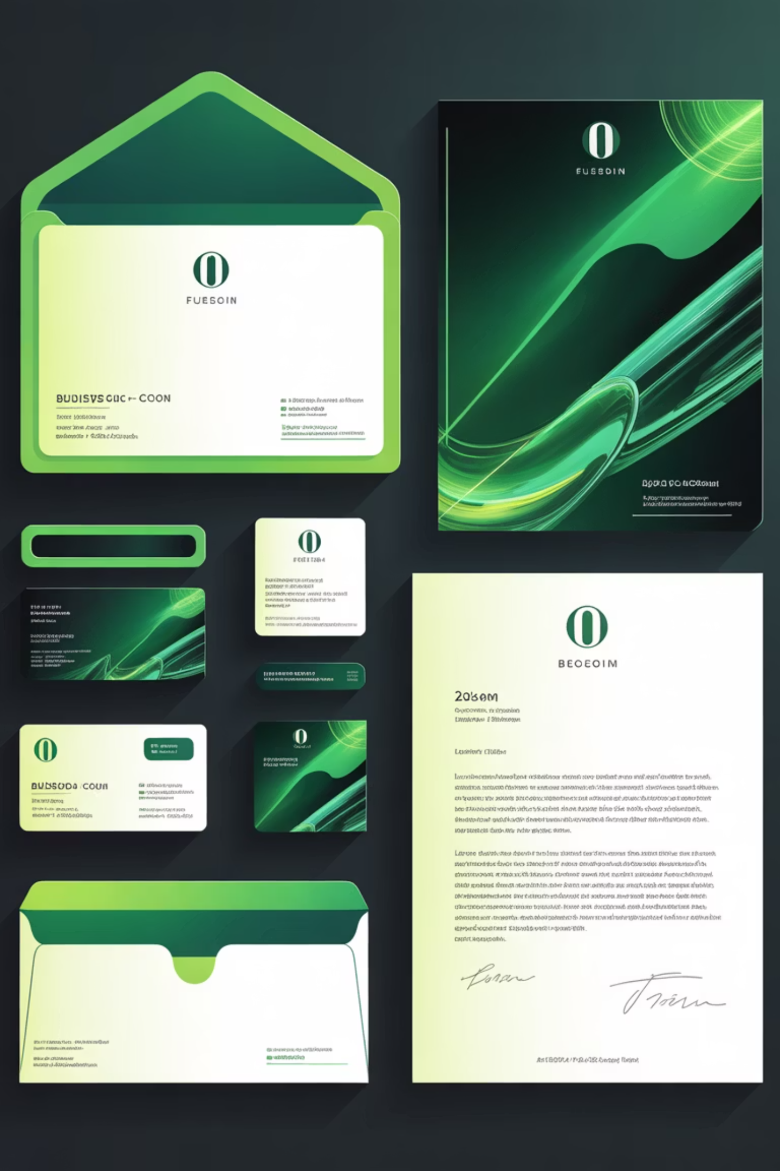
Brand Applications
Business Collateral
Letterhead, invoices, business cards, and envelopes — all anchored by the Convergence Mark and the emerald accent system.
Digital Presence
App icons (512px to 48px), favicons, social media kit, email signatures — consistent IHRAZ identity across every touchpoint.
Presentations
Dark-theme PowerPoint templates featuring emerald accents and bold Syne typography — designed to command the boardroom.
Document Watermark
Transparent Convergence Mark at 22% opacity applied to all official documents — a subtle stamp of authenticity and ownership.

Slide 10
The Numbers
The scale and precision behind every IHRAZ brand decision — told in the only language that never lies.
451
2
5
18
Codebase Files
Core Modules
Data Streams
Brand Assets
PMO Hub and KPI Dashboard — unified by one data layer
Converging data paths embodied in the Convergence Mark
Identity deliverables crafted and ready for deployment
Lines of product foundation powering the IHRAZ platform
1
Source of Truth
One unified intelligence platform. One vision. One IHRAZ.
IHRAZ — ACHIEVE. ATTAIN. SCORE.

