Slide 1


IHRAZ — AI-Powered Enterprise Performance Platform
Saudi Born. Globally Engineered.
IHRAZ.AI

Slide 2

Where Data Converges Into Strategic Advantage
IHRAZ transforms fragmented project and performance data into unified intelligence — enabling leaders to see what matters, act on what's real, and achieve what others only plan.
The Convergence Mark
What This Means for You
Five data streams converging into a single apex of strategic insight — the visual foundation of the IHRAZ identity and philosophy.
No more siloed dashboards. No more fragmented reports. One platform, one truth, one place to lead from.

Slide 3
IHRAZ BRAND IDENTITY PRESENTATION
Agenda
A structured journey through identity, architecture, and experience — everything that defines the IHRAZ platform.
01
02
03
The Brand
The System
The Experience
Visual identity, core values, and strategic market positioning that set IHRAZ apart in the enterprise landscape.
Platform architecture, engineering foundations, and the two core modules powering enterprise performance.
User journey, design system principles, and the interface philosophy that keeps leaders in command at all times.

Slide 4
CHAPTER 01
The Brand
Three pillars define everything IHRAZ builds, communicates, and delivers. These are not marketing constructs — they are engineering commitments encoded into every layer of the platform.
Convergence
Intelligence
Performance
Disparate data streams unite into a single, actionable intelligence layer. Every signal finds its purpose at the apex.
Deep, contextual insights derived from a fully unified data ecosystem — not just reporting, but understanding.
Engineered for enterprise-grade speed, uncompromising reliability, and infinite scalability across global operations.

Slide 5
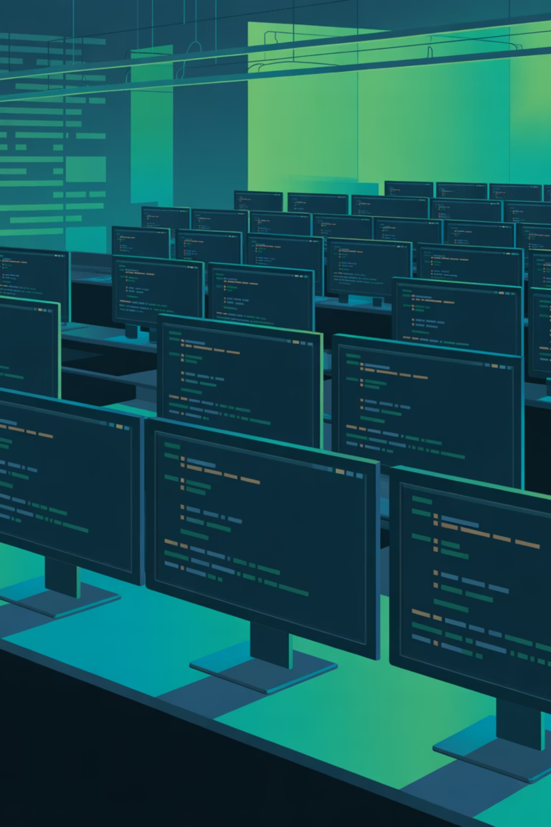
CHAPTER 02
451 Files of Enterprise Intelligence
IHRAZ is not a concept — it is a fully engineered production platform. Built on React, TypeScript, and Supabase, the architecture spans 451 production files across two core modules, each designed to meet the exacting demands of enterprise-scale deployment.
451
3
2
Production Files
Core Technologies
Platform Modules
Spanning two enterprise-grade modules
PMO Hub and KPI Dashboard
React, TypeScript, Supabase

Slide 6
Platform Architecture
Two purpose-built modules form the backbone of the IHRAZ platform — each engineered to solve a distinct enterprise challenge while sharing a unified data foundation.
PMO Hub Module
KPI Dashboard Module
Portfolio Management — End-to-end project portfolio visibility across the enterprise
Timeline Tracking — Milestone-level precision with dynamic scheduling
Resource Allocation — Optimize team capacity and deployment in real time
Risk Intelligence — Proactive identification and mitigation of project risk
Real-Time Metrics — Live performance data with zero lag across all functions
Performance Dashboards — Executive-grade visualization tailored to decision-makers
Predictive Analytics — Forward-looking intelligence to stay ahead of outcomes
Custom Reporting — Configurable outputs aligned to organizational frameworks

Slide 7

Performance is not measured. It is engineered.
— IHRAZ Philosophy

Slide 8
BUILT FOR ENTERPRISE SCALE
Performance Benchmarks
Every architectural decision in IHRAZ is made in service of one goal: zero compromise on enterprise performance. These are not targets — they are guarantees built into the platform from the ground up.
99.9% Platform Uptime
Under 200ms Response
Infinite Scalability
Cloud-native architecture designed to scale seamlessly from single-team deployments to global enterprise rollouts without re-engineering.
Enterprise-grade reliability with fault-tolerant infrastructure ensuring leaders are never without their intelligence layer.
Sub-200 millisecond response times across all platform interactions — because leadership decisions cannot wait for slow dashboards.

Slide 9
LOOKING AHEAD
Strategic Roadmap
IHRAZ is built for today's enterprise and engineered for tomorrow's demands. A four-year evolution from foundational platform to global AI intelligence leader.
2025 — Foundation
1
Core platform modules and enterprise infrastructure fully deployed and production-ready.
2
2026 — Expansion
Deep AI integration, advanced analytics capabilities, and expanded enterprise partnerships.
2027 — Evolution
3
Proprietary predictive intelligence models trained on enterprise performance data at scale.
4
2028 — Mastery
Full global enterprise reach, positioning IHRAZ as the world standard in AI-driven performance intelligence.

Slide 10


Let's Converge
The next era of enterprise performance intelligence begins with a conversation. IHRAZ is ready to transform how your organization sees, acts, and leads.
Platform
Contact
ihraz.ai
mz@ihraz.ai
Headquarters
Riyadh, Saudi Arabia
Saudi Born. Globally Engineered. — IHRAZ is proud to be rooted in the Kingdom of Saudi Arabia, built to serve enterprise leaders across every continent.

